Slide 1
Gesture Detection Using Image Processing with Python

Slide 2
INDEX
INTRODUCTION
WORKING AND ALGORITHM
ANALYSIS
ADVANTAGES AND LIMITATION
FUTURE ENHANCEMENT

Slide 3
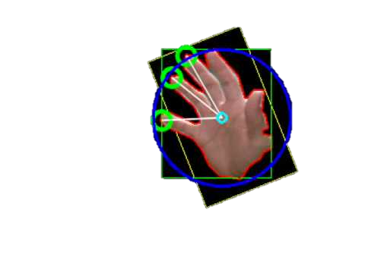
INTRODUCTION
We are living in a world where technology controls more of our daily activities than we do ourselves, technology has integrated into our daily lives to such an extent that is not easy for us to comprehend about how far we have come. We cannot imagine a single day without the use of modern technology, It has become an essential part of our lives and will continue to do so. It will keep on improving day by day and there is virtually no possible way we could ever be able to stop it.

Slide 4
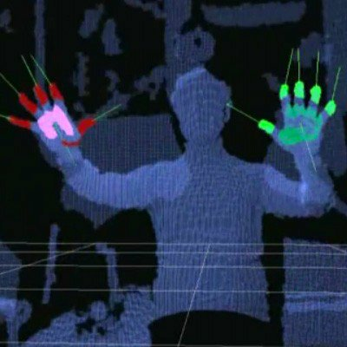
Abstract
This project involves fundamentals of image processing and python with various algorithms to detect some of the basic gestures or input that can be provided through the camera of either a laptop/PC or other devices such as an infrared or an Ultraviolet sensor. The program can be used to return values of numbers or messages related to different gestures respectively.

Slide 5

HUUUHHH WHAT WOULD BE THE ALGORITHM????

Slide 6
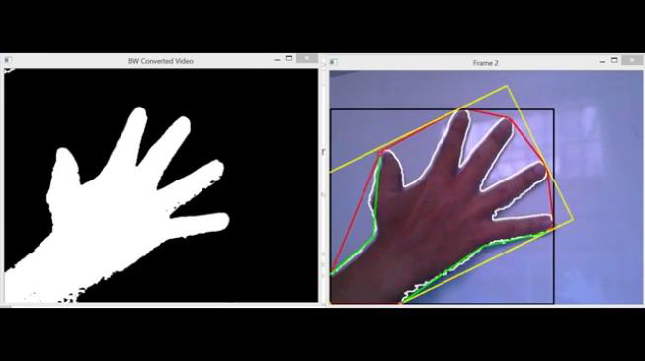
Creation of Mask
1. The sensor captures the image of the object (the hand in this case).
2. Since an image is being used here, the range of the skin color is set in hex values for the computer to identify and differentiate it.
3. If an Ultrasonic, infrared or thermal sensor is used the range is set according to the data provided by the sensor.
4. The pixels that are within the range of the skin color are identified and the whole image is converted to binary (black and white).

Slide 7
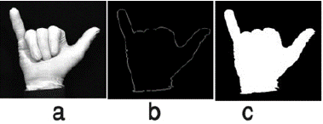
Measuring Contour Ratio
Contour Ratio is the value that is attained by dividing the areas of the black and the white pixels respectively.
it gives us an idea about how much screen space is occupied by the object in the frame
It will be helpful later to determine and differentiate gestures with the same number of defect points.

Slide 8
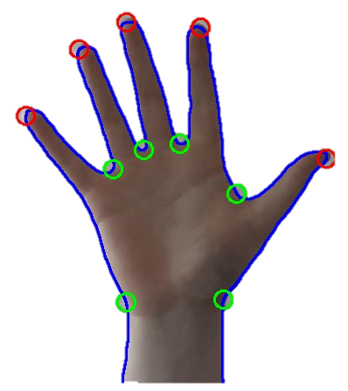
Finding Defects
Defects are gaps between the fingers within the contour map.
They can be measured by finding the range of the angles between the fingers.
If the angle is between a certain range (< 90 ) we can consider it as a defect.
The number of defects combined with the contour ratio can help us determine the gesture
Defects
Defects
.

Slide 9
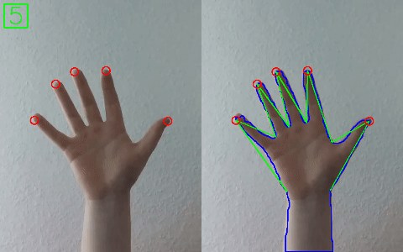
Final Calculation
The contour ratio and the defects are used to determine the final gesture.
If the defect is equal to 1, it signifies the use of ‘two’ fingers
If it is 2 or 3, it would mean that there are ‘three’ or ‘four’ fingers respectively.
3 fingers could also mean the ’Ok’ sign, so it is corrected by using a different contour ratio.
One and ‘Best of luck sign’ appear when there are zero defects within a certain range of contour ratio.
.

Slide 10
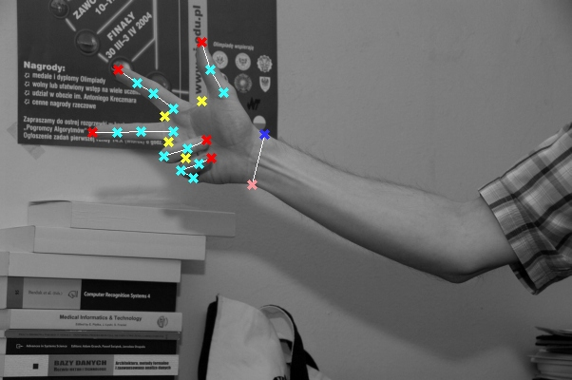
ANALYSIS
Hand gesture recognition system is used as human computer interaction medium as well as for paralyzed persons so it’s useful current technology.
To achieve the goal of system several tools and technologies have been used.
The study of tools and technologies and the previous technologies used are studied and researched thoroughly.
Open CV:
Computer vision:
Deep learning:

Slide 11
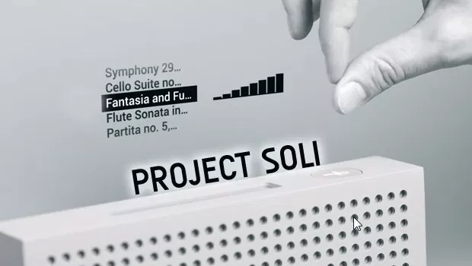
Future Enhancement
A lot of technological fields have already implemented gesture technologies in Smart Homes, Cars and other Internet of things devices. A good example could be Project Soli by Google where Radar technology is used to track
micro motions. Some recent reviews explained gesture recognition system applications and its growing
importance in our life especially for Human computer Interaction, Robot control, games,
and surveillance, using different tools and algorithms.

Slide 12
Common Uses:
Sign Language Recognition
Robot Control
Virtual Environments
3D Modelling

Slide 13
Advantages and limitation
LIMITATION :
Detection of Object just by the use of colors might not be affective
Different Gestures might have similar Contour Maps
Detection of more than one color would need high levels of optimization.
Performance of algorithm decreases when ideal needs of distance and light are not fulfilled.
ADVANTAGES :
Immediate and powerful interaction
Intuitiveness and enjoy ability

Slide 14

Made and Designed By:
Chandra Shekhar
Swapneel Shubham
Taher Ali
Ritu Verma

